Slide 1



Biofortification of Zinc and Iron Enriched Cultivated Species of Pleurotus florida
K.K.Gupta¹ ,Manish², Manoj³ and R.K .Singh⁴
1, 2 – Cytogenetic & Molecular Biology Lab., University
Department of Zoology, VBU, HZB
3, 4- Krishi Vigyan Kendra (An ICAR Unit), Canary Hill, Hazaribag

Slide 2
INTRODUCTION
Green revolution in 1965 for making self sufficient India, although enhanced the quantitative production of agricultural products
But recent use of many chemicals by the name of pesticides or insecticides have affected the qualititative production of food.
Researchers and scientists in recent years have thus developed the fortified food to improve the quality of agricultural products.

Slide 3
Biofortification
WHO (world health Organization ) and FAO (food and agricultural Organization of the united Nation
defined
“Fortification as the practice of deliberately increasing the content of an essential micronutrient i.e Vitamins and minerals (including trace element) in crops .
This is done to improve the nutritional quality of the food supply and to provide a public health benefit with minimal risk to health” for example;-
iron-biofortification of rice, beans, sweet potato, cassava and legumes;
zinc-biofortification of wheat, rice, beans, sweet potato and maize;
provitamin A carotenoid -biofortification of sweet potato, maize and cassava; and.
amino acid and protein -biofortification of sorghum and cassava.

Slide 4
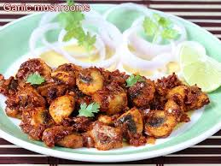
FOOD
ROYAL SOUP
AS
ORNAMENTAL
ITEM
MEDICINE
IMPORTANCE OF MUSHROOM
At present it is very much recognized in restaurant and included in our day to day life. It is a food of choice in party.

Slide 5
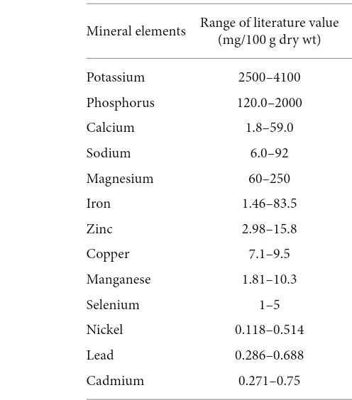
Good Source of Nutrient
contain about 39.9% carbohydrate, 17.5% protein and 2.9% fat, the rest being minerals.
Metal concentration in mushrooms are considerably higher then those in agricultural crops, vegetables and fruits.
This suggests that mushrooms posses effective mechanisms that enables them to readily take up of some metals from the ecosystems compared to the green plants growing in similar localities .

